Slide 1
HealthChain Cannabis Prescriber 2.0
Adam Cole

Slide 2
Demographics & Prescribed
Demographics
Name, DOB (age), Gender (at birth)
Optional: Identifies as, weight, height, photo
Treatment: Condition(s), symptom(s)
Contraindications: Hx, Med Hx
Filters
Strain, CBD >=, THC <=, format
Show secondary filters
Suggest
In stock, avoid munchies, avoid intoxication, avoid drowsiness
List
Strain, LP, CBD, THC, forma, rating, in-stock, price
Details
Big picture, description, Total grams
Strain: Indica, Sativa, Hybrid
Format: Dried, oil, decarb, blend, Softgels, Dissolve strips
Src: https://www.auroramj.com/strains/
Filters
Suggest
List
Details

Slide 3
Scratch work follows

Slide 4
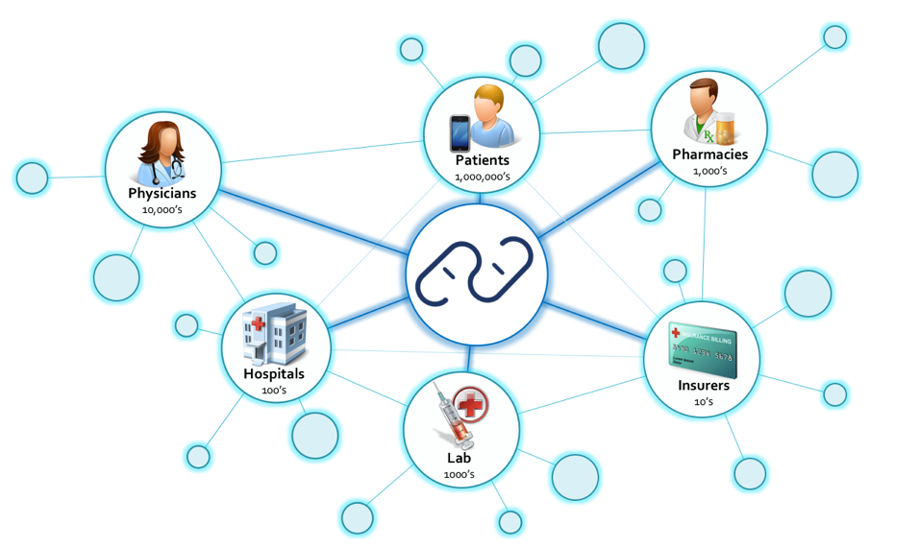

Slide 5
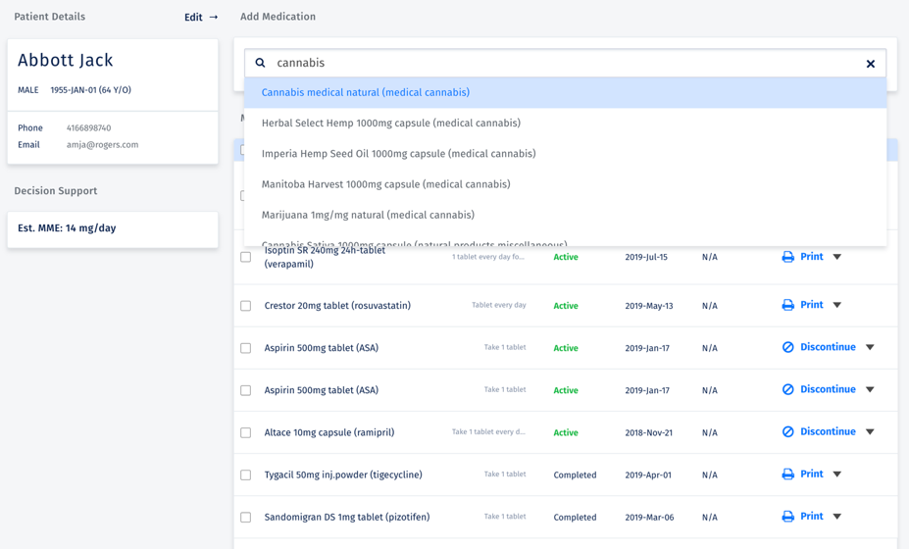

Slide 6
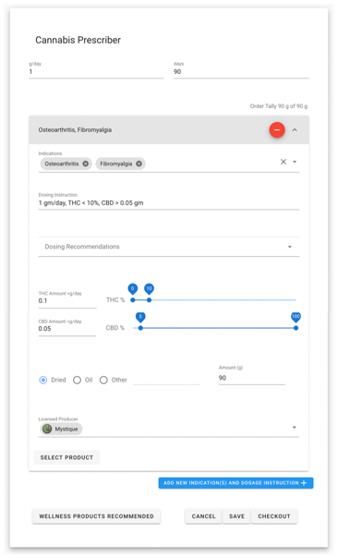

Slide 7
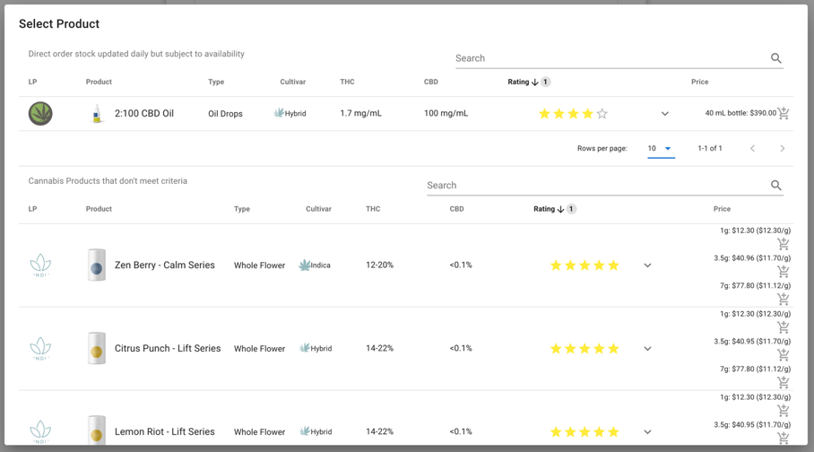

Slide 8
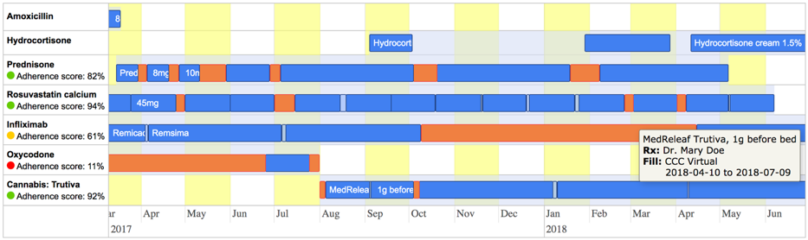

Slide 9
